Slide 1
AUTOCAD

Slide 2
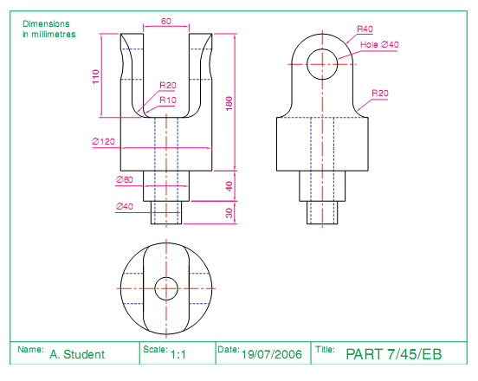
CTTI
AutoCAD overview Mechanical

Slide 3
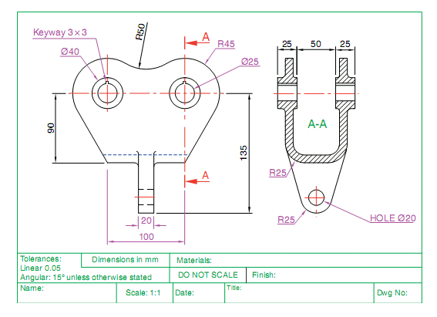
CTTI
AutoCAD overview Mechanical

Slide 4
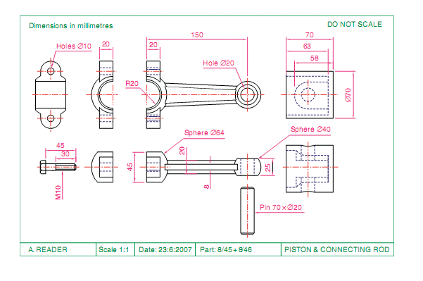
CTTI
AutoCAD overview Mechanical

Slide 5
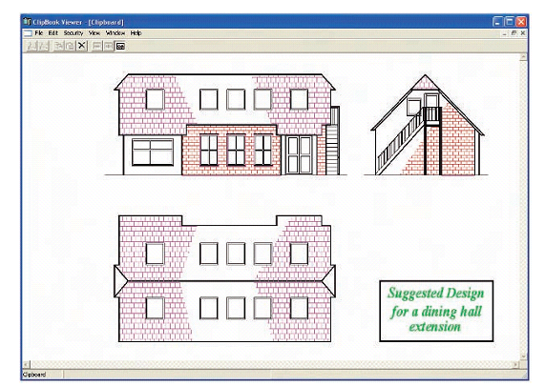
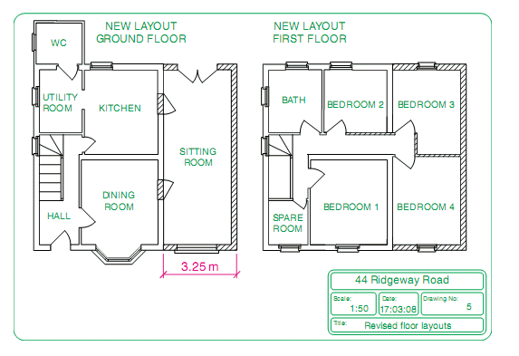
CTTI
AutoCAD overview Civil

Slide 6
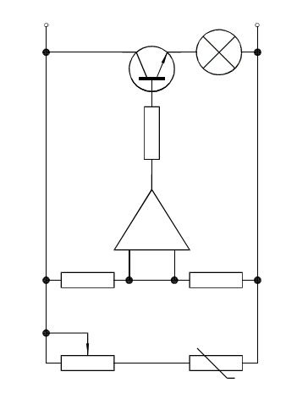
CTTI
AutoCAD overview Electrical

Slide 7
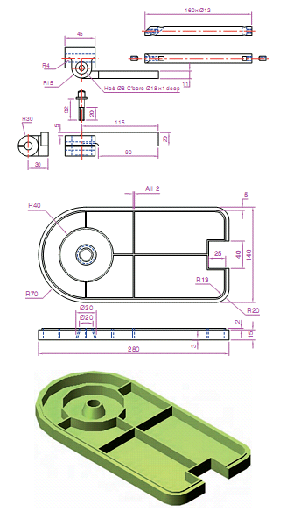
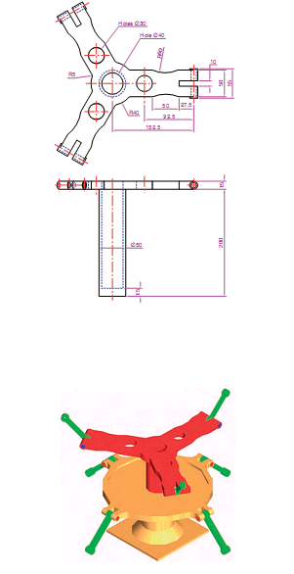
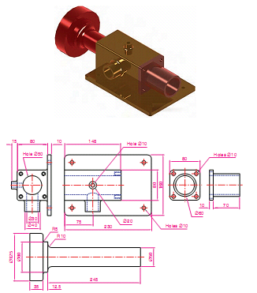
CTTI
AutoCAD overview 3D

Slide 8
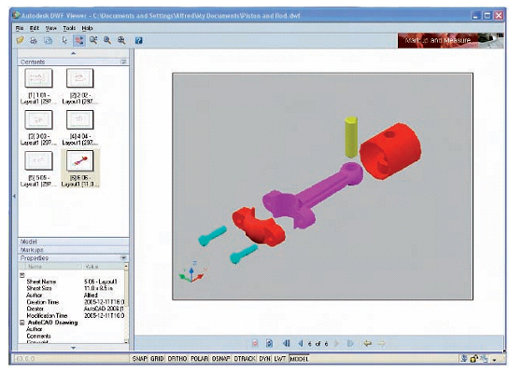
CTTI
AutoCAD overview 3D

Slide 9
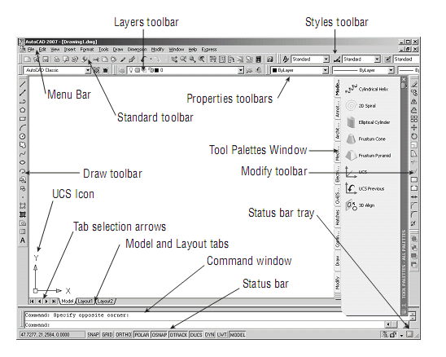
CTTI
AutoCAD Window

Slide 10
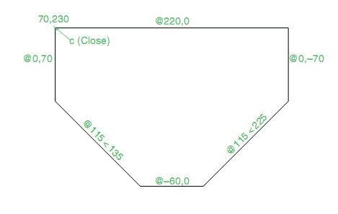
CTTI
Line Command

Slide 11
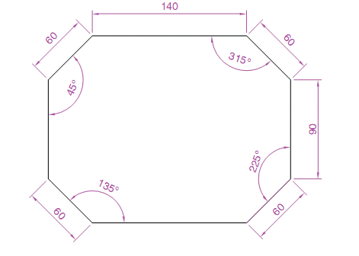
CTTI
Line Command Exercise-2

Slide 13
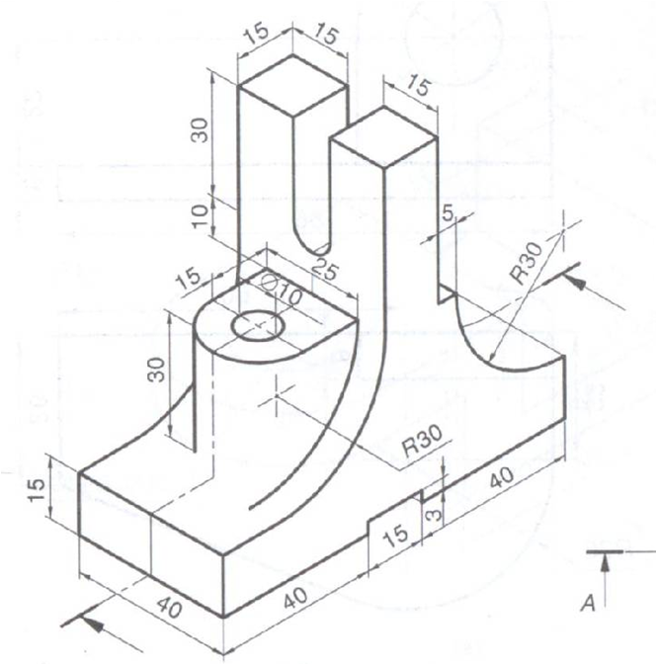

Slide 14
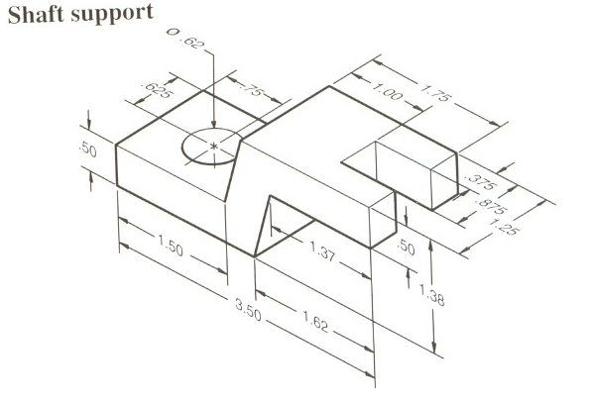

Slide 15
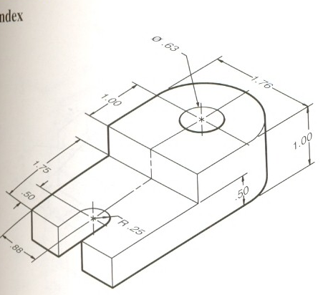

Slide 16
END
Lesson 1

